Slide 1
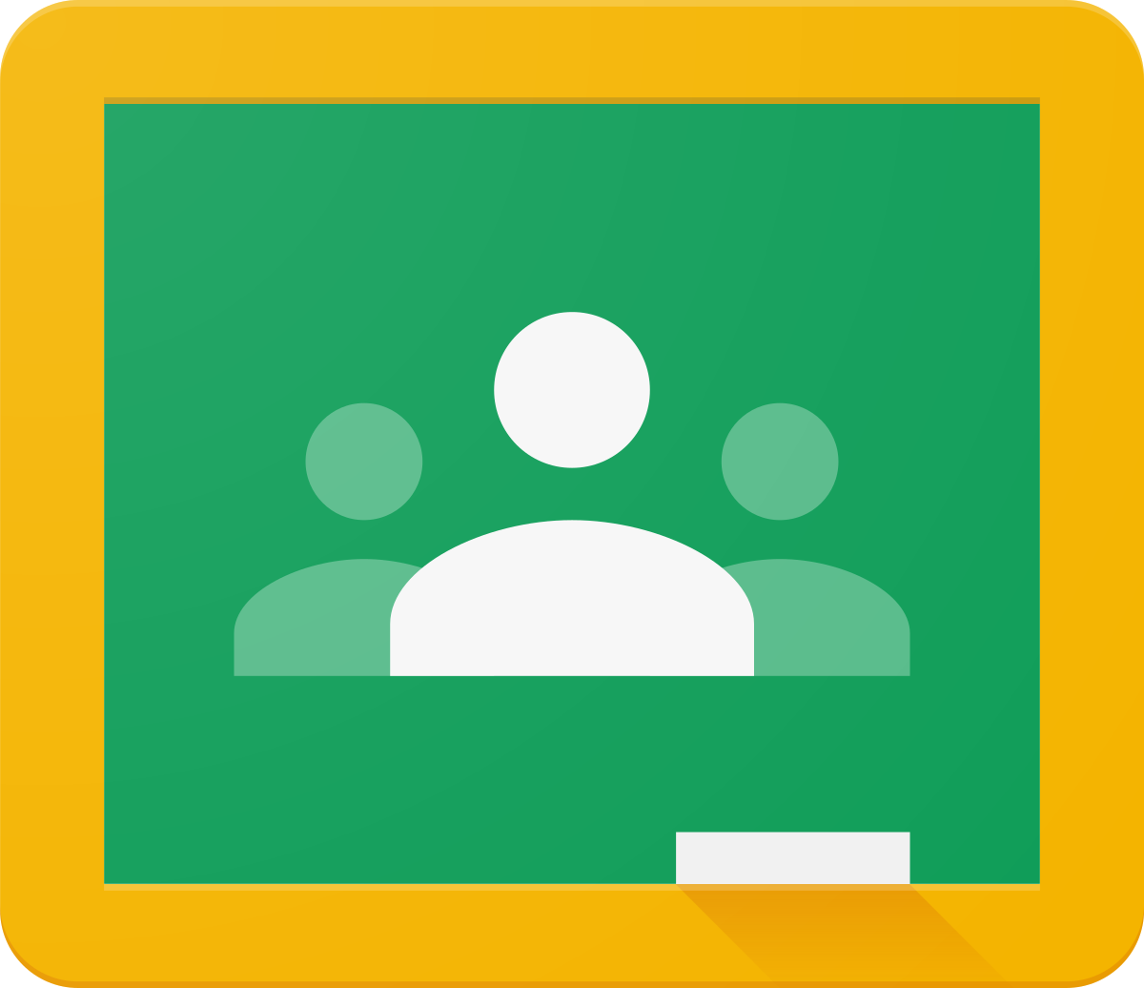
How to use Google Classroom

Slide 2

GUIDELINES FOR TEACHERS:
Open GMAIL Account
Go to Google apps
Select Class Room icon
Click on + icon to create a Classroom
Give the Details such as Class Name, Section , Subject and Room
Click on create and your Classroom is Available with given name.
Open the Classroom. Provide a Class code to students or link to join.
Now Teachers can use the Classrooms to post instructions, create assignments.

Slide 3
GUIDELINES FOR STUDENTS:
Open GMAIL Account
Go to Google apps
Select Class Room icon
Click on + icon to JOIN a Classroom
Enter the Class code provided by teachers to join the classroom.
Now students can see all the details posted by teachers.
Students can submit there assignments on google classroom.

Slide 4
Thank you!

